Slide 1
Gauss law

Slide 2
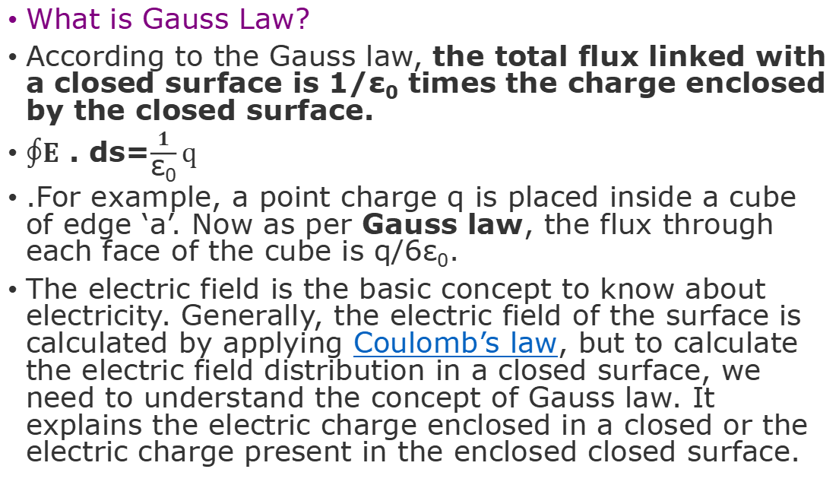
What is Gauss Law?
According to the Gauss law, the total flux linked with a closed surface is 1/ε₀ times the charge enclosed by the closed surface.
$∮E$ . ds=$\frac{1}{\text{ε}\text{0}}q$
.For example, a point charge q is placed inside a cube of edge ‘a’. Now as per Gauss law, the flux through each face of the cube is q/6ε₀.
The electric field is the basic concept to know about electricity. Generally, the electric field of the surface is calculated by applying Coulomb’s law, but to calculate the electric field distribution in a closed surface, we need to understand the concept of Gauss law. It explains the electric charge enclosed in a closed or the electric charge present in the enclosed closed surface.

Slide 3
Gauss Law Formula
As per the Gauss theorem, the total charge enclosed in a closed surface is proportional to the total flux enclosed by the surface. Therefore, if ϕ is total flux and ϵ₀ is electric constant, the total electric charge Q enclosed by the surface is;
Q = ϕ ϵ₀
The Gauss law formula is expressed by;
ϕ = Q/ϵ₀
Where,
Q = total charge within the given surface,
ε₀ = the electric constant.

Slide 4
The Gauss Theorem
The net flux through a closed surface is directly proportional to the net charge in the volume enclosed by the closed surface.
Φ = → E.d → A = q_{net}/ε₀
In simple words, the Gauss theorem relates the ‘flow’ of electric field lines (flux) to the charges within the enclosed surface. If there are no charges enclosed by a surface, then the net electric flux remains zero.
This means that the number of electric field lines entering the surface is equal to the field lines leaving the surface.

Slide 5
The Gauss theorem statement also gives an important corollary:
The electric flux from any closed surface is only due to the sources (positive charges) and sinks (negative charges) of electric fields enclosed by the surface. Any charges outside the surface do not contribute to the electric flux. Also, only electric charges can act as sources or sinks of electric fields. Changing magnetic fields, for example, cannot act as sources or sinks of electric fields.

Slide 6


Slide 7
The net flux for the surface on the left is non-zero as it encloses a net charge. The net flux for the surface on the right is zero since it does not enclose any charge.
⇒ Note: The Gauss law is only a restatement of the Coulombs law. If you apply the Gauss theorem to a point charge enclosed by a sphere, you will get back Coulomb’s law easily

